Slide 1
Strategies for Leading change and developing talent taipei, taiwan August 30, 2016
© Sandford Borins 2016
Professor of Management, University of Toronto
Research Fellow, Harvard Kennedy School

Slide 2
Outline of Presentation
Defining public sector innovation
Innovation research
Frontline entrepreneurs as leaders
Political leadership
Developing talent to innovate

Slide 3
Defining Public Sector Innovation
Initial adoption of a process, policy, or technology by a public sector organization
Invention: first adoption of a process, policy, or technology by any public sector organization
Private sector innovation motivated by profit, use patents to create monopolies
Public sector innovation motivated by service and professionalism, freely shared
Notes:
Though public sector organizations can be bureaucratic, hierarchical, and risk-averse, they can also be innovative

Slide 4
Innovation Research
(Brookings, 2014)
(IBM Center for The Business of Government, 2014)
Notes:
IBM report available online
cover has three messages about innovation: it is achievable, it involves cooperation (rope), and requires reducing risk (helmet)

Slide 5
Innovation Research
Innovating with Integrity: How Local Heroes are Transforming American Government (Georgetown, 1998)
Explored previously unrecognized role of local heroes, or frontline entrepreneurs, in bottom-up innovation
Notes:
Local hero is someone who will never be famous but does things that are heroic or innovative

Slide 6
Innovation Research
Studies of applications to Innovations in American Government (Harvard Kennedy School) Awards
Initial research 1990s, replicated for 2010
Both quantitative and qualitative
Characteristics and process of psi
What has and hasn’t changed about innovation in government
Guide for innovative public servants
Notes:
Qualitative research is often individual case studies
Someone can make recommendations on the basis of one case study
Someone else can make conflicting recommendations on the basis of a different case study
Quantitative research attempts to determine which of the two conflicting scenarios is more likely
Joke among qualitative researchers that the plural of anecdote is data
I’d put it differently – the plural of data is more data
My research influenced the field to become quantitative

Slide 7
Why Study Innovations in American Government Award Applicants?
Ideal data base for understanding PSI
Prestige and energetic outreach attracts applications
Open to all levels of US government and all policy areas
Semifinalist application requires detail on process, characteristics, outcomes, assessment, replication
2/3 of applications first time, average age = 6 years
Notes:
HKS awards have been given on an annual basis since 1986
Comprehensive semifinalist questionnaire has remained the same, permits comparisons over time

Slide 8
Innovation Research
Coded all 217 semifinalist applications in 1990s and 127 in 2010
Research assistant and me, 90% inter-coder reliability
Statistical analysis of coded results
Qualitative analysis by policy area and interviews of selected applications
Also studied innovation award applications from Canada and British Commonwealth (53 countries)

Slide 9
Key Results
High incidence of interorganizational collaboration
Importance of frontline entrepreneurship
More often problem solving than crisis response
More often planning than incrementalism
Obstacles exist and were overcome
Results achieved and innovations transferred
Notes:
80 % interorganizational collaboration
50 % frontline entrepreneurship
70 % problem-solving, 30 % maximum crisis
70 % planning
Obstacles primarily internal bureaucratic, some external or resources
Overcome through persuasion and accommodation
Results include impact on clients and efficiency of public sector production
60 % transferred

Slide 10
More Innovation Research
European Commission 2010 survey of 4000 public organizations in 27 EU countries
Organization for Economic Cooperation and Development (OECD) observatory of public sector innovation (280 + innovations)

Slide 11
Frontline Entrepreneurs as Leaders
50% of innovations originated from front-line public sector workers or middle managers
Victor Grech
Michael Fenn
Sonya Meinert
Allison Hamilton
Notes:
These people are local heroes: they aren’t famous, but they have done important things for their community as public servants
Victor Grech a Maltese doctor who built a computerized database on Malta’s population with heart disease using his own computer and software
Michael Fenn – a disabled public servant (blindness from diabetes) who convinced Parks Canada to make historic sites accessible to elderly and to people with disabilities; Taught course to students about design for disabilities, had student competition to make a nearby historic house accessible
Sonya Meinert, a human services caseworker in Texas who designed a program to provide volunteer interpreters to clients not fluent in English

Slide 12
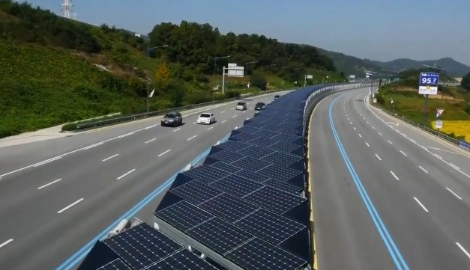
Front-line Entrepreneurs as Leaders
Notes:
Hamilton: idea to have solar panels on highway medians or edges to power lights (replicate Germany)
collaboration of dept of energy, solar energy sector, Portland General Electric
federal highway administration in Washington (interstate highway system)
“reasons to reject project only words written on paper long ago”

Slide 13
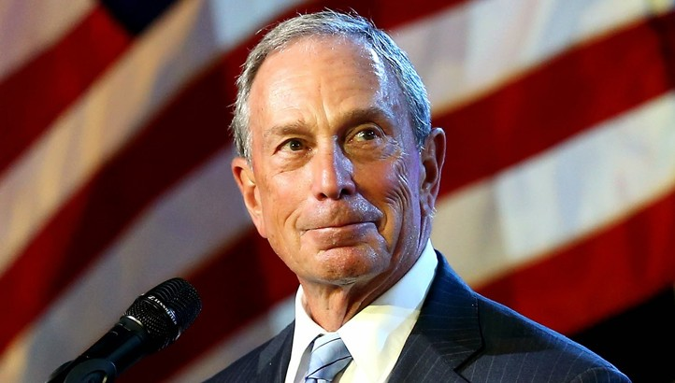
Political Leaders as Innovators
Notes:
This is Michael Bloomberg, former mayor of New York, responsible for numerous innovations
At 2009 inauguration Pres. Obama spoke about a new spirit of public service
Bloomberg wanted a program designed to allow citizens to volunteer, for example helping vaccination programs for H1N1 virus
Ordered his staff to design it very quickly, and they did. And it worked.

Slide 14
Political Leaders as Innovators
Notes:
Prime Minister Trudeau
First-ever cabinet with gender parity
“Because it’s 2015!”

Slide 15
Different Innovation Paths
Political innovation as crisis response
Frontline innovation as problem solving
Political innovators look for support from other politicians, media, business
Frontline innovators look for support internally, from their supervisors
Notes:
Results from my research
Correlations between initiator of innovation and reason for innovation and
Between initiator of innovation and sources of support for innovation

Slide 16
Political Support for Frontline Innovation
Informal support (thank you letters, commendations, invitations to high-profile events)
Formal support for reinvention labs (in the 1990s) or innovation labs (in the 2010s)
Protection from external criticism
Notes:
Governor of Oregon wrote letter to Allison Hamilton
Robert Reich, US Secretary of Labor in the Clinton Administration, invited innovative public servants to ceremonies where President Clinton signed legislation they helped design and to watch fireworks on July 4 from roof of Department’s head office
Clinton Administration reinvention labs
Global trend for government departments to establish innovation labs

Slide 17
Developing Talent for Innovation
Establish innovation labs (design thinking, big data analytics)
Create community of practice in innovation (to cross organizational boundaries)
Creativity training for public servants
Hiring a new generation of public servants
Establish innovation awards for public servants
Notes:
Different innovation labs have different approaches
Community of practice: public servants in different departments interested in innovation meet
Creativity training: new ways of thinking
Innovation awards: to encourage innovation and to communicate innovation among public servants

Slide 18
Identify and Learn from Serial Innovators
Notes:
Elon Musk, a private sector serial innovator

Slide 19
Identify and Learn from Serial Innovators
Notes:
Larry Rosenstock, a public sector serial innovation
Believes in importance of integrating vocational training and academic training in high schools
Was principal of high schools that implemented this philosophy successfully in Cambridge, Massachusetts and in San Diego, California
Applied in both 1990s and in 2010 (how I became aware of him)

Slide 20
Openness to Society
Open data – make government data sets available to the public
Challenges – public competitions to complete a project for the public sector (reengineered procurement)
Hackathons
Public service outreach
Notes:
Challenges reengineer procurement because the government selects a winner after all the applicants have completed the project
Public service outreach: go to conference with private sector innovators and with public sector innovators from other places

Slide 21
A Culture of Public Service Innovation
Notes:
Australians have attempted to make their country a nation that is a leader in public service innovation
Other countries are doing this too
Will Taiwan also be part of global public sector innovation culture?

